Slide 1
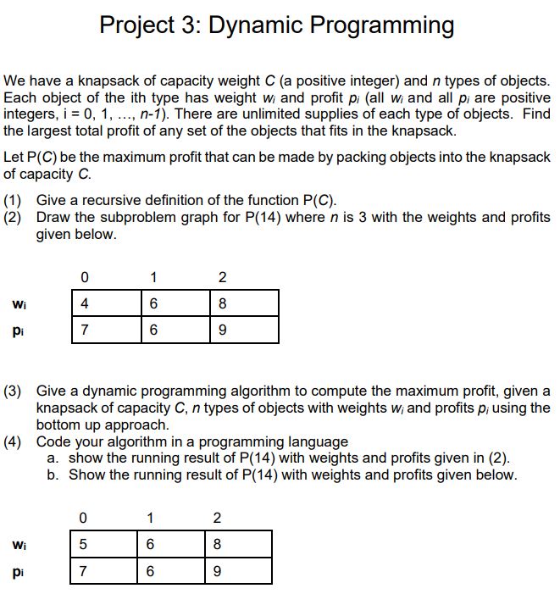

Slide 2
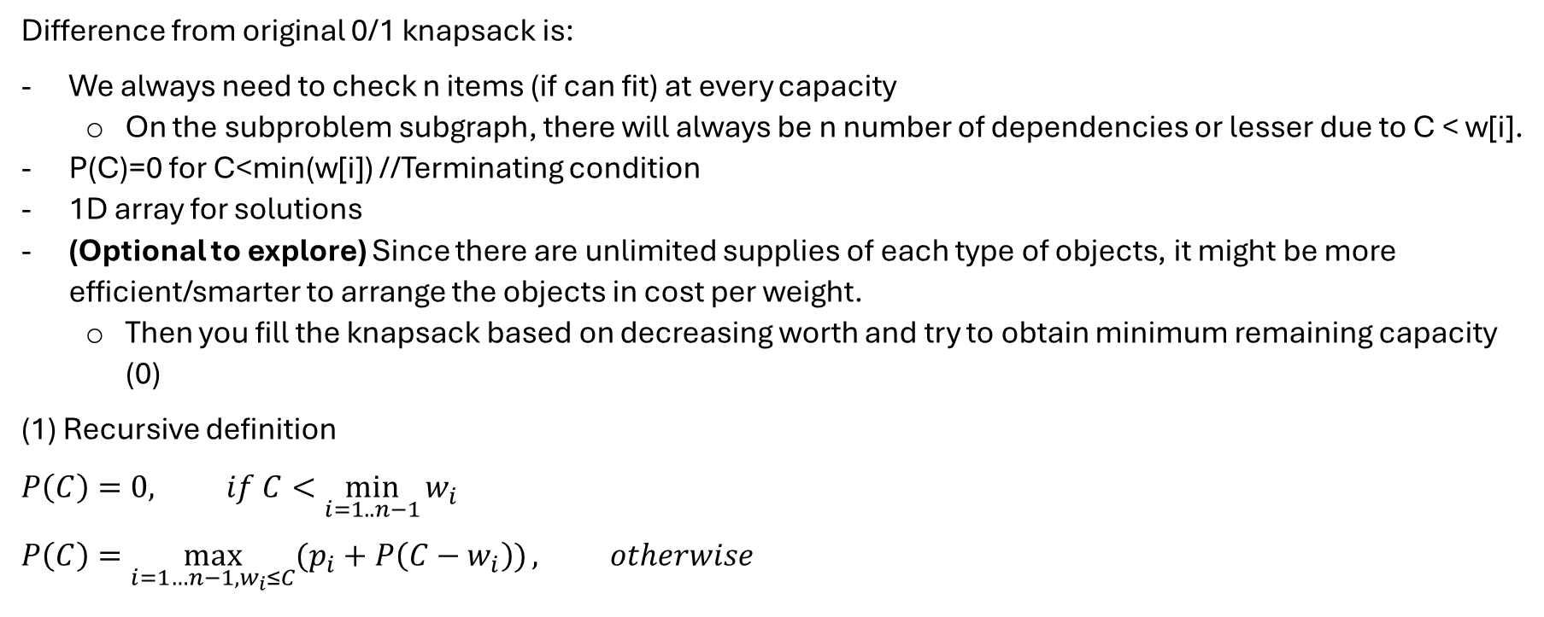
Difference from original 0/1 knapsack is:
We always need to check n items (if can fit) at every capacity
On the subproblem subgraph, there will always be n number of dependencies or lesser due to C < w[i].
P(C)=0 for C<min(w[i]) //Terminating condition
1D array for solutions
(Optional to explore) Since there are unlimited supplies of each type of objects, it might be more efficient/smarter to arrange the objects in cost per weight.
Then you fill the knapsack based on decreasing worth and try to obtain minimum remaining capacity (0)
(1) Recursive definition
$$P\left(C\right)=0, if C<\min_{i=1..n−1}{w_{i}}$$
$$P\left(C\right)=\max_{i=1…n−1, w_{i}≤C}{(p_{i}+P\left(C−w_{i}\right))}, otherwise$$

Slide 3
P(14)
P(8)
P(6)
P(10)
P(6)
P(2)
P(0)
P(4)
P(2)
P(0)
P(4)
P(0)
P(2)
P(0)
P(2)
P(0)

Slide 4
14
12
10
8
6
4
2
0

Slide 6
i (w, P) \C | 0 | 1 | 2 | 3 | 4 | 5 | 6 | 7 | 8 | 9 | 10 | 11 | 12 | 13 | 14
0 (5, 7) | 0 | 0 | 0 | 0 | 0 | 7 | 7 | 7 | 7 | 7 | 14 | 14 | 14 | 14 | 14
1 (6, 6) | 0 | 0 | 0 | 0 | 0 | 7 | 7 | 7 | 7 | 7 | 14 | 14 | 14 | 14 | 14
2 (8, 9) | 0 | 0 | 0 | 0 | 0 | 7 | 7 | 7 | 9 | 9 | 14 | 14 | 14 | 16 | 16
Basically, every rows give access to 0 – i item, we compare whether P[r][c] = max(P[r][c-w_i] + p_i, P[r-1][c])
i (w, P) \C | 0 | 1 | 2 | 3 | 4 | 5 | 6 | 7 | 8 | 9 | 10 | 11 | 12 | 13 | 14
0 (4, 7) | 0 | 0 | 0 | 0 | 7 | 7 | 7 | 7 | 14 | 14 | 14 | 14 | 21 | 21 | 21
1 (6, 6) | 0 | 0 | 0 | 0 | 7 | 7 | 7 | 7 | 14 | 14 | 14 | 14 | 21 | 21 | 21
2 (8, 9) | 0 | 0 | 0 | 0 | 7 | 7 | 7 | 7 | 14 | 14 | 14 | 14 | 21 | 21 | 21

